Slide 1




FELIX MUKUNGU
Founder, The Core
Bitcoin Educator
Printing Services
MukunguFelix
Felix Divoar
felixdivoar

Slide 2


CHAPTER 8
HOW TO USE BITCOIN

Slide 3
“ We’re building the Visa network for bitcoin. But what I think is powerful, is unlike Visa, anybody can build on top of it.
Elizabeth Stark

Slide 4
Technologies typically grow and expand in layers, like a stack. Think of your favorite website, email, or social media: they were built on top of the internet protocol, which was built on top computers, which were built on top of electricity, and so on. These technologies started out with a very simple design and continued to improve over time.

Slide 5
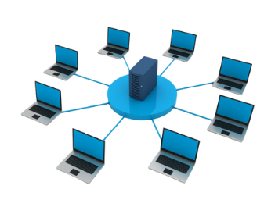
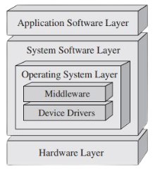
Bitcoin is no exception. As Andreas Antonopoulos famously put it, “Bitcoin is the Internet of Money.” It is the base layer of sound digital money, providing a solid foundation upon which new technology will be built.

Slide 6
satoshi
Bitcoin
1
10
100
1,000
10,000
100,000
1,000,000
10,000,000
100,000,000
0.00000001
0.00000010
0.00000100
0.00001000
0.00010000
0.00100000
0.01000000
0.10000000
1.00000000

Slide 7
The Lightning Network
The Lightning Network serves as a payment system facilitating quick and cost-effective transactions with bitcoins. It operates by establishing a shared wallet where both parties hold some bitcoins. They can conduct numerous transactions between each other without the need to record each one
on the main ledger. The final balance is then recorded on the ledger once the transactions are complete.

Slide 8
The Lightning Network
The Lightning Network is a payment system that allows users to send and receive payments quickly and inexpensively using bitcoin. It works by setting up a shared wallet where both people store their bitcoins and then making unlimited transactions between each other without touching the main blockchain. When they're done, the final balance is recorded on the main blockchain.

Slide 9
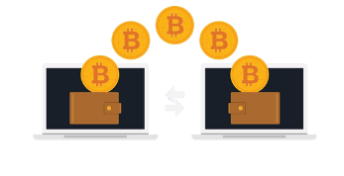
On-Chain Transactions:
These are transactions that happen directly on the Bitcoin blockchain. They take about 10 minutes to confirm and the fees depend on the size of the transaction in bytes. They are more secure but slower.

Slide 10
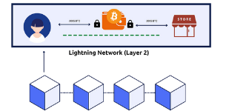
Off-chain transactions (Lightning Network)
These transactions happen on a separate network built on top of the Bitcoin blockchain. They are settled faster and with lower fees.

Slide 11
Payment Network | Bitcoin Network | Lighting Network
Definition | A decentralized digital network that uses cryptography to secure financial transactions | A second layer payment protocol that operates on top of the Bitcoin blockchain, enabling faster and cheaper transactions
Advantages | Decentralized and secure. No chargebacks or fraud. Can be used anonymously. Global acceptance | Faster and cheaper transactions. Increased scalability. Off-chain transactions do not clog the blockchain
Disadvantages | Slow transaction times. High fees for certain types of transactions. Complex for beginners | Requires trust in the channel operators. Still experimental and not widely adopted. Requires on-chain transaction to open and close channels

Slide 12
Self-Custodial vs Custodial Wallets
Lightning wallets can be broken down into very specific categories, but for the sake of simplicity, we’ll divide them into two: self-custodial and custodial.
Just like Bitcoin wallets, a self-custodial Lightning wallet is one where you control the keys to the wallet, whereas a custodial Lightning wallet is one where someone else controls the keys. When using a custodial wallet, you’re only given access to the wallet, but you depend on someone else for
permission to use your money; you’re giving up ownership of your money for convenience.

Slide 13
Self-Custodial vs Custodial Wallets
This can be acceptable for small amounts, although it’s recommended to use a self-custodial wallet once you have an understanding of the technology.
Open Source vs Closed Source
Just like the Bitcoin wallets we saw in the previous chapter, Lightning wallets can be open-source or closed source. Always use open-source wallets as they are completely open for review and vetted by the community.
An open-source application also means that anyone can contribute to the improvement of the software, making it a better choice for users.

Slide 14
Setting up a Bitcoin Lightning Wallet
Setting up a self-custodial Bitcoin Lightning wallet is the same as setting up a self-custodial on-chain Bitcoin wallet.
How to create and use a Bitcoin Lightning wallet.
1. Search for the app in the App Store (iOS) or Google Play Store (Android).
2. Open the app and type in your 12- or 24-word recovery phrase (sometimes called a seed phrase).Be sure to write it down and keep this in a safe place!
This recovery phrase allows you to recover full access to your funds if needed.

Slide 15
How to create and use a Bitcoin Lightning wallet.
3. You must then confirm that you have actually saved your recovery or seed phrase. To do this, you
4. As an additional measure of security, some wallets allow you to choose a secure password.
5. Generate a Lightning invoice, address, or QR code to receive bitcoins. Transfer bitcoins to your wallet. With a self-custodial wallet, you cannot always buy bitcoins directly with fiat, so you might need to purchase and transfer it from an exchange first.

Slide 16
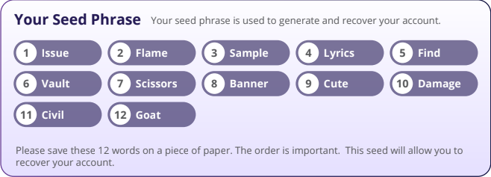

Slide 17
Sending and Receiving Lightning Transactions
With a Lightning wallet, using Bitcoin is fast, cheap, and private, making transactions between two people easy. You can quickly send and receive bitcoins for everyday things like buying coffee or shopping.

